Slide 1

SCHOOL MANAGEMENT SYSTEM
Presented by: AJJA ANASS
12/21/2023

Slide 2

PLAN
INTRODUCTION
UML DIAGRAM
CLASSES & OBJECTS
DEMO
CONCLUSION

Slide 3

C#
INTRODUCTION

Slide 4

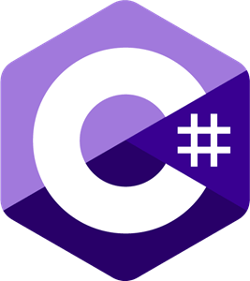
INTRODUCTION
C#
C# (pronounced "See Sharp") is a modern, object-oriented, and type-safe programming language. C# enables developers to build many types of secure and robust applications that run in .NET.

Slide 5
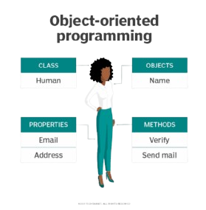
INTRODUCTION
OOP
Object-oriented programming (OOP) is a computer programming model that organizes software design around data, or objects, rather than functions and logic. An object can be defined as a data field that has unique attributes and behavior.

Slide 6

INTRODUCTION
About The Project
My C# Project is a School Management System. This System will be a Console Application called “DICCEPONLE”, emphasizing object-oriented principles. Offering functionalities to manage students, teachers, courses, and administrative tasks.

Slide 7
UML DIAGRAM
C#

Slide 8
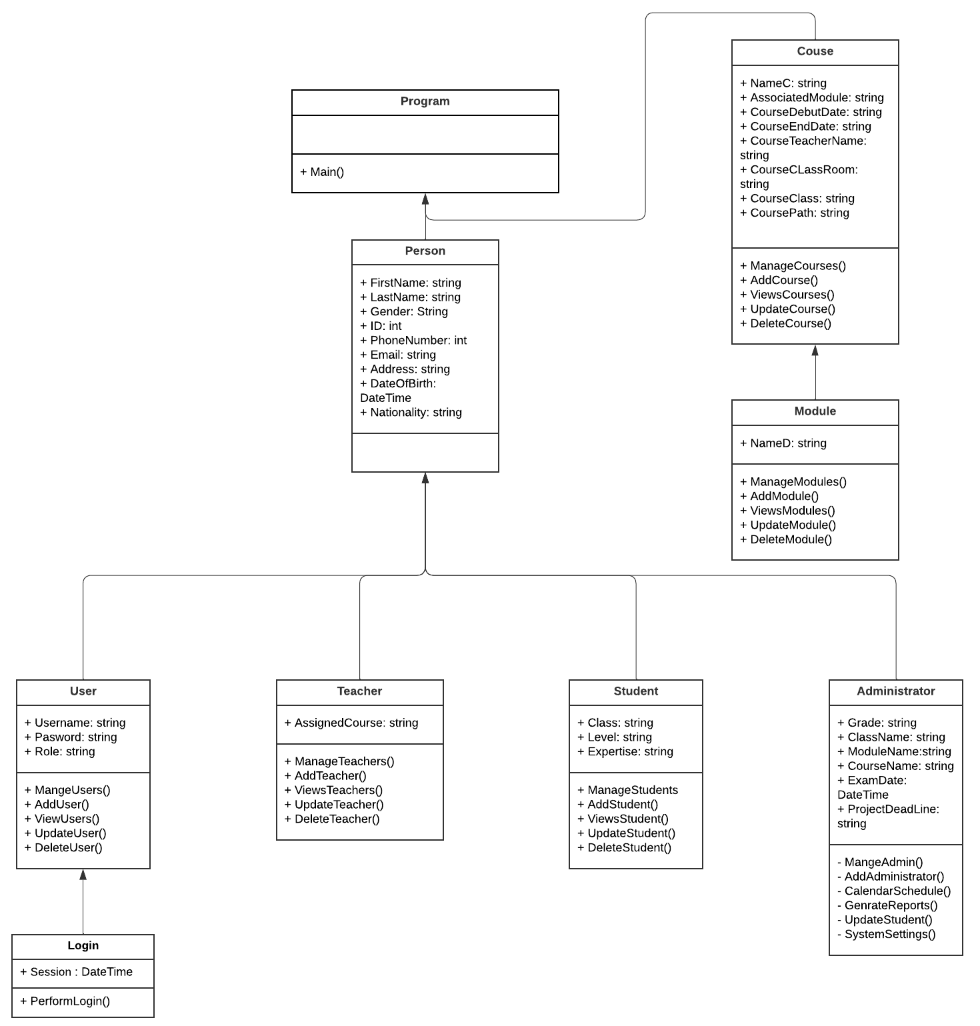
UML DIAGRAM
C#
This is a UML Class Diagram Representing my C# Oriented Object Project Structure

Slide 9
C#
CLASSES & OBJECTS

Slide 10

CLASS PERSON
C#

Slide 11
CLASS STUDENT
C#

Slide 12
CLASS TEACHER
C#

Slide 13
CLASS ADMINISTRATOR
C#

Slide 14
CLASS USER
C#

Slide 15
CLASS LOGIN
C#

Slide 16
CLASS COURSE
C#

Slide 17
CLASS MODULE
C#

Slide 18
CLASS PROGRAM
C#

Slide 19
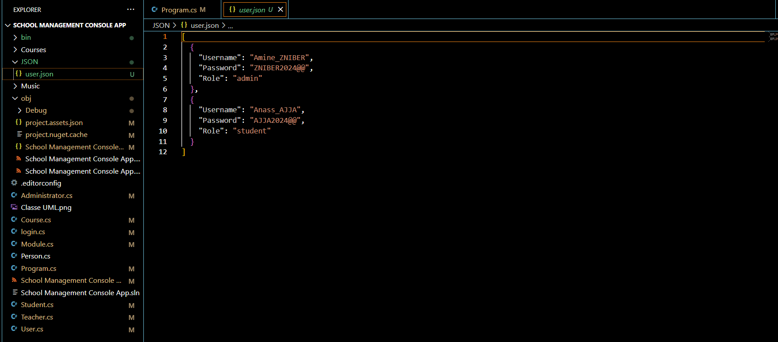
DATA PERSISTENCE
C#
Store and retrieve data from JSON files

Slide 20
C#
DEMO

Slide 21

Conclusion
In summary, this project demonstrates the successful implementation of a School Management System, empowering administrators with the tools necessary for efficient and organized school administration.

Slide 22



THANK YOU
AJJA Anass
+212 778-360864
Anass.ajja@ynov.com

